Slide 1

Project Title
MMD3
Date:
Library Application
(Team Name)
Sun Nasy
Keo Sovanlongdy
Ny Sreynich
Seng Sokchan
Chea Tuseth

Slide 2
Library Application
Description
Our application is very important for people who want to find and read the book by only their own hand phone . For admin can update and delete data and user can login their account for reading book.
Team Name - Project Name

Slide 3
Library Application
People easily use our application because they don’t have to pick their book together and they can read a lot of books by their own phone every where. Almost people who use our application are student and teacher. Our application will help them to save time and their money to buy the books.
Team Name - Project Name

Slide 4
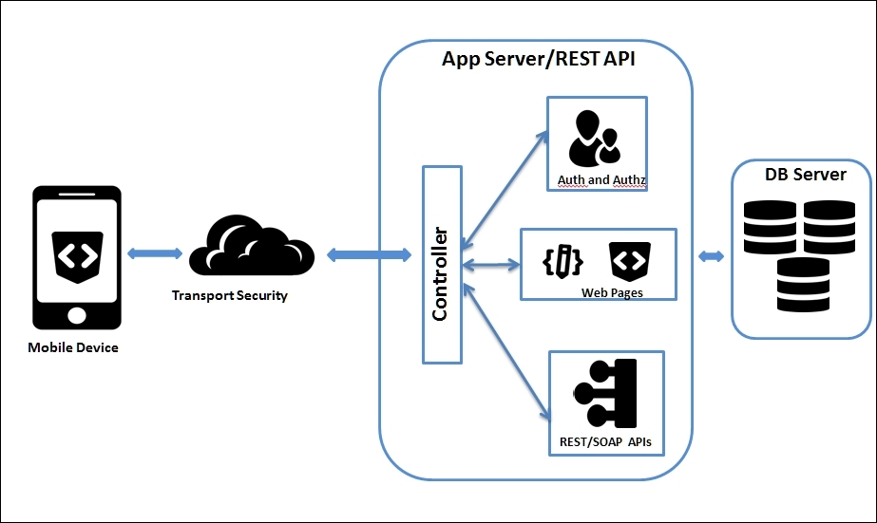
Project Architecture
Description
very briefly describe what your application architecture will design.

Slide 5
Project Methodology
Description
very briefly describe what your application will implement.

Slide 6
Project Technologies and Tools
very briefly describe what technologies and tools are used to develop your application.

Slide 7
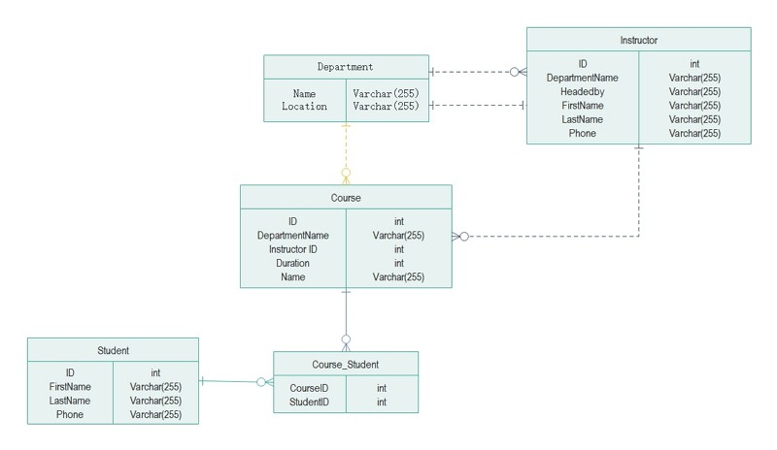
Database Design
Delete this text box and use this slide to visually show what the 1st two screens of your database might look like.
Team Name - Project Name

Slide 8
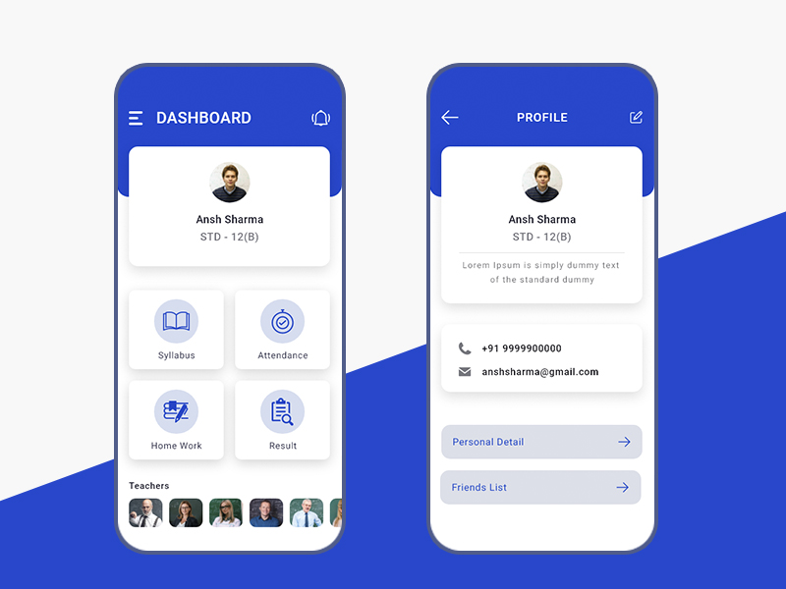
User Interface Design
Delete this text box and use this slide to visually show what the 3rd & 4th screens of your application might look like.
Team Name - Project Name

Slide 9
Future Plans

